Slide 1
Structure Odour Relationship Study of Acyclic Monoterpene Alcohols, their Acetates and Synthesized Oxygenated Derivatives
A Doctoral Thesis
by
Shaimaa Awadain Elsharif
MSc of Pharmaceutical Chemistry
November, 2017

Slide 2
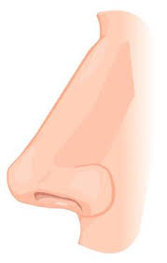
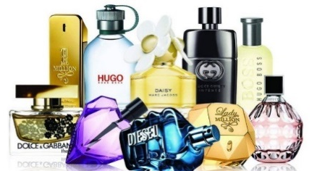
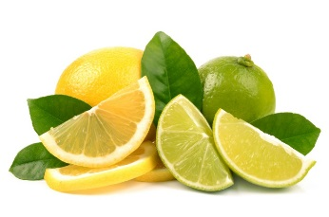
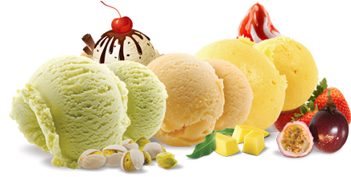
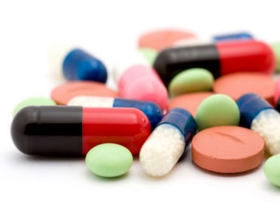
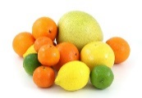

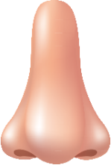

Motivation
Linalool
Nerol
Geraniol
β- Citronellol
8-Hydroxylinalool
8-Carboxygeraniol

Slide 3
Outline
Introduction
Terpenes
Acyclic monoterpene alcohols
Research Methodology
Experimental
Observations and Results
Structure odor relationships
A Comparative Approach
Conclusion

Slide 4
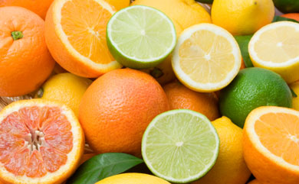
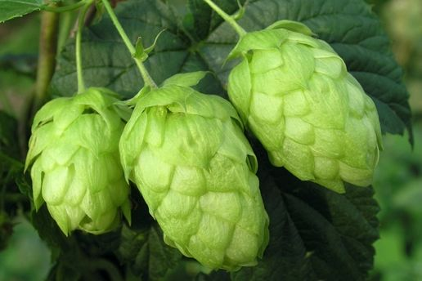
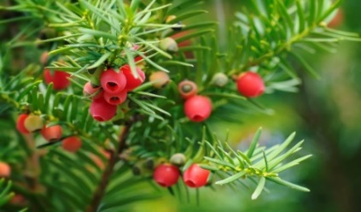
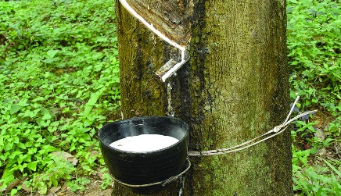
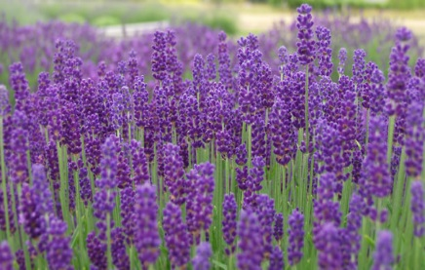
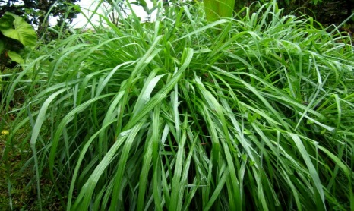
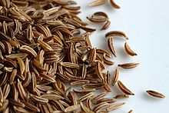
Terpenes
Monoterpenes
Sesquiterpenes
Diterpenes
Polyterpenes
Isoprene
(C₅H₈)_{n}
C₁₀H₁₆
C₁₅H₂₄
C₂₀H₃₂
(C₅H₈)_{n = 4000-5000}
Limonene
Humulene
Taxol
Rubber
Linalool
Citronellal
Carvone
Terpenoids

Slide 5
Terpenes (cont.):
+
3
Isopentenyl diphosphate
(IPP)
Glyceraldehyde-
3-phosphate
Dimethylallyl diphosphate
(DMAPP)
Pyruvate
Acetyl CoA
Mevalonate
Pathway
(MVA)
Methylerythritol
Phosphate
Pathway
(MEP)
MVA
MEP
Monoterpenes
Geranyl diphosphate
Sesquiterpenes
Farensyl diphosphate

Slide 6
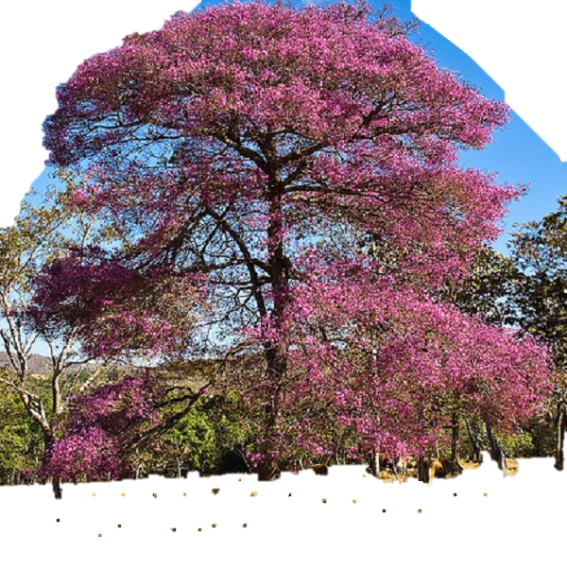
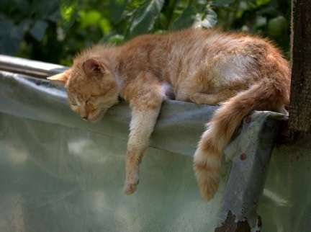
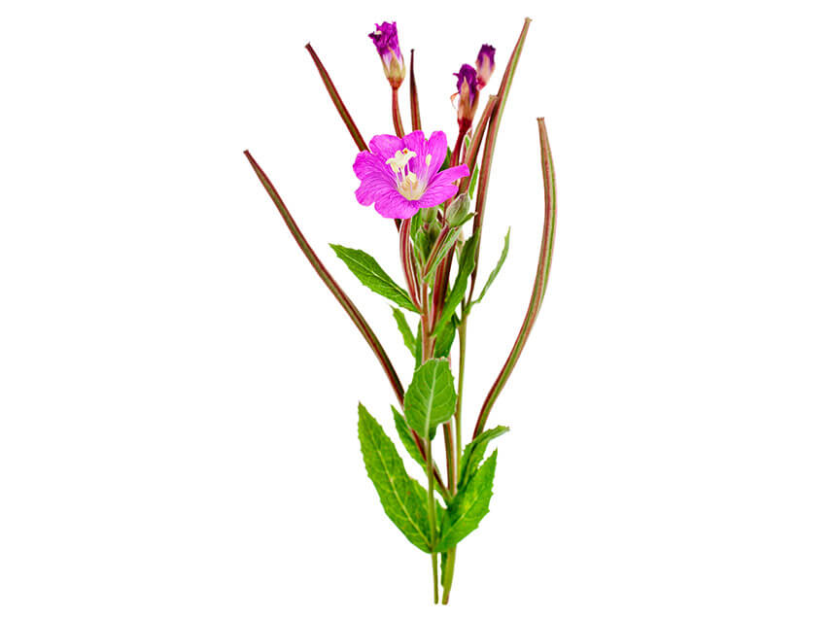
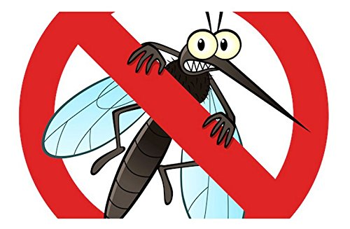
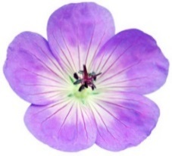
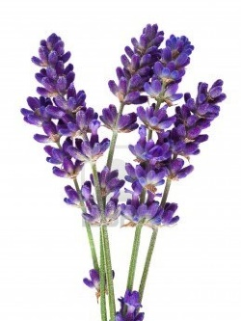
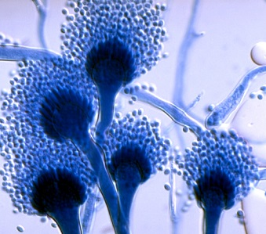
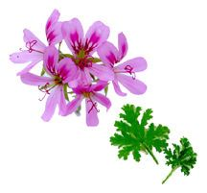
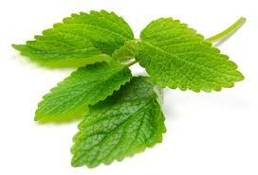
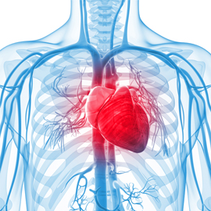
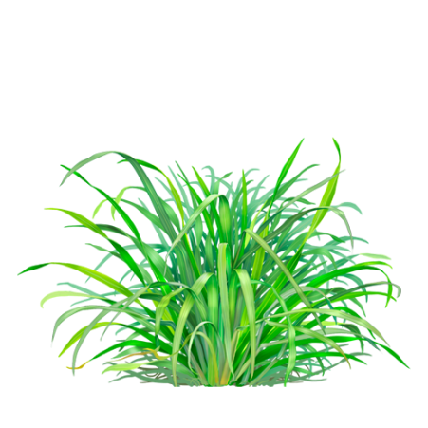
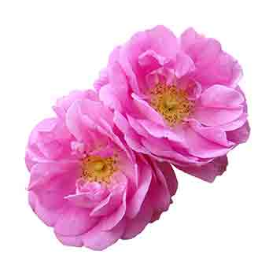
Acyclic Monoterpene Alcohols
Occurrence / Uses
Linalool
Geraniol
Nerol
Citronellol
Notes:
Monoterpenes used in this thesis are classified under the class of acyclic monoterpene alcohols since they all have an alcoholic functional group in their structures.
These monoterpenes are linalool, citronellol, and the isomers: geraniol and nerol.
First lets know where are these monoterpenes mostly found in nature: linalool is commonly found in rosewood tree, odor described in lit as citrus, floral, fresh, lavender flowering tops, used as sedative, hypnotic and in sleeping-aid drugs. Geraniol is found in palmarosa , geranium flower, odor described as berry-like, rose-like. Used as a potent mosquito repellent and due to its low toxicity used as a natural pest control.
Nerol, in Melissa, rosa damascene (damask rosa),having an odor of floral, citrus-like as previously described.
Nerol : has the highest antifungal activity against some Aspergillus strains; indicating its capability to be a food preservative in food products
Citronellol is found in pelargonium flower, and various lemon grass species., smells rose-like, sweet, floral. Citronellol on the other hand has several cardiovascular effects, among them is its hypotensive and vasorelaxation activities.
In regard to their pharmacaological activites, it was important to study their metabolic pathways and identify their metabolites.

Slide 7
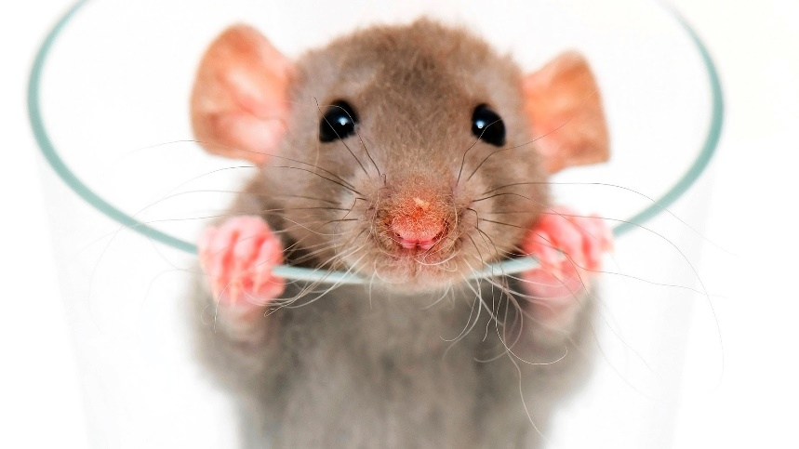
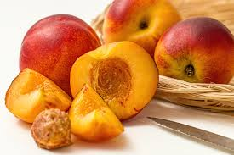
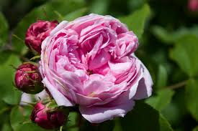
Acyclic Monoterpene Alcohols (cont.):
^{[1-3]}
Metabolites
8-Hydroxylinalool
8-Carboxylinalool
8-Hydroxygeraniol
8-Carboxygeraniol
8-Hydroxynerol
8-Hydroxycitronellol
[1] Chadha and Madyastha 1984
[2] Aubert, Ambid et al. 2003
[3] Knapp, Straubinger et al. 1998
Notes:
So, what are the main metabolites?
linalool and geraniol metabolites were isolated from the urine of rats after oral administration and it was found that both monoterpenes undergo oxidation at C-8
Yeilding the 8- hydroxyl and the 8-carboxy derivatives as major metabolites after 20 days. In addition, Several studies showed the oresence of these metabolites in some plant species.
The 8-hydroxylinallol is found in muscat grape skin, while the 8-carboxylinalool is found in fruits of Euterpe oleracea (a species of palm tree)
Meanwhile, 8-hydroxygeraniol is present in yellow fleshed nectarines, where the 8-carboxy geraniol is found in tongling white ginger
The metabolites of nerol and citronellol were also identified in some plants, where the 8-hydroxanerol was found in the yellow-fleshed nectarines and grape berries and the 8-hydroxyl citronellol found in rose flowers (rose damascenea)

Slide 8
Research Methodology
 | Group 1 | Group 2 | Group 3
Monoterpene Alcohols | Linalool | a) Geraniol b) Nerol | Citronellol
Monoterpene Acetates | Linalyl acetate | Geranyl acetate Neryl acetate | Citronellyl acetate
Oxygenated Derivatives
Oxygenated Derivatives

Slide 9
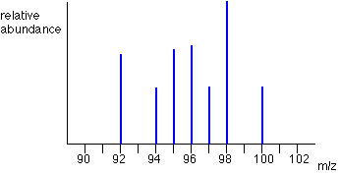

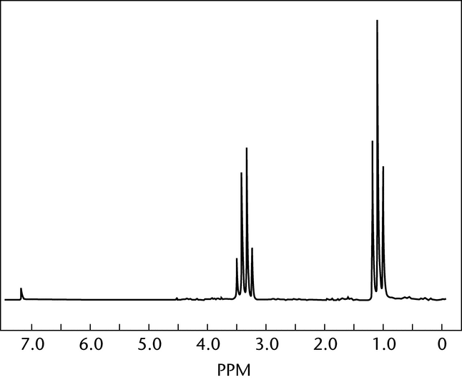
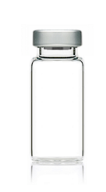
Research Methodology
Synthesis
Sensory analysis
Structure-odour relationships
MS
NMR
1:2
1:2
1:2
1:2
Citrus, fresh
Fatty, musty
1
2
4
8
16
FD
AEDA
ppm
Notes:
After this introduction on the monoterpenes now comes the work flow
First I synthesized these derivatives and metabolites, then they are subjected to sensory analysiswhere their odor quality and threshold are measured, and finally a structure odor relationship is done
Structural elucidation via Ms, and NMR
Sensory analysis by GC-O for the odor quality and threhosld

Slide 10
Experimental
Synthesis
1
2
R1=H---Linalool
R1=Ac--Linalyl acetate
SeO₂/ Dioxane ^{[8]}
NaBH₄/dry MeOH ^{[9]}
80°C / 5 h
-10°C / 1 h
8-Oxo derivatives
R2= H---(E)-Geraniol
\(Z)- Nerol
R2=Ac--(E)-Geranyl\
(Z)-Neryl
acetate
3
NaClO₂ /
t-BuOH /
NaH₂PO₄
2-methyl-
2-butane ^{[10]}
RT / overnight
8-Hydroxy derivatives
R3=H--Citronellol
R3=Ac-Citronellyl acetate
24 Synthesized derivatives
8-Carboxy derivatives
[8] Wakayama, Namba et al. 1973
[9] Liu, Chen et al. 2003
[10] Pinnick, Bal et al. 1981

Slide 11
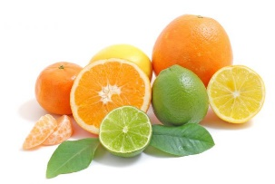
Sensory Analysis
1-Linalool / Linalyl acetate ^{[11]}
Panel:
7 females, 1 male
Ages=(28-33)
Anosmia = 0
Linalool
8-Oxolinalool
8-Hydroxylinalool
8-Carboxylinalool
(Citrus, lemon-like, soapy, fatty)
(Citrus)
(Odorless)
3.2 ng/L
38 ng/L
160 ng/L
----
Odorant | Odor Threshold [ng/L(air)] |  |  |  |  |  |  |  | Group OT
 | P1 | P2 | P3 | P4 | P5 | P6 | P7 | P8
Linalool |  | 8.4 | 2.1 | 2.1 |  | 2.1 | 4.2 | 2.1 | 3.2
8-Oxolinalool |  | 38 | 19 | 76 |  | 9.5 | 305 | 19.1 | 38
8-Hydroxylinalool |  | 989 | 247 | 247 |  | 31 | 494 | 62 | 160
8-Carboxylinalool | - | - | - | - | - | - | - | - | -
8.4
2.1
305
4.8
989
7.7
[11] Elsharif, Banerjee et al. 2015

Slide 12
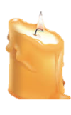
Sensory Analysis
1-Linalool / Linalyl acetate (cont.) ^{[11]}
Panel:
7 females, 1 male
Ages=(28-33)
Anosmia = 0
Linalyl
acetate
8-Oxolinalyl
acetate
8-Hydroxylinalyl
acetate
8-Carboxylinalyl
acetate
(Citrus, lemon-like, soapy, fatty)
(Citrus, fatty)
(Fatty, musty, waxy!)
111 ng/L
5.9 ng/L
103 ng/L
6.1 ng/L
Odorant | Odor Threshold [ng/L(air)] |  |  |  |  |  |  |  | Group OT
 | P1 | P2 | P3 | P4 | P5 | P6 | P7 | P8
Linalyl acetate | 407 | 203 | 51 | 102 |  | 203 | 407 | 51 | 111
8-Oxolinalyl acetate | 2.8 | 4.9 | 4.9 | 79 |  | 4.9 | 10 | 10 | 5.9
8-Hydroxylinalyl acetate |  |  | 40 | 79 |  | 317 | 317 | 20 | 103
8-Carboxylinalyl acetate | 3.1 | 3.1 | 6.1 | 6.1 |  | 24 | 24 | 6.1 | 6.1
12.7
0.6
634
634
4.9
1.5
[11] Elsharif, Banerjee et al. 2015

Slide 13
Structure Odor Relationship
1-Linalool / Linalyl acetate (cont.) ^{[11]}
Linalool
Linalyl acetate
8-Oxolinalyl acetate
3.2 ng/L
111 ng/L
5.9 ng/L
(Citrus, lemon-like, soapy, fatty)
(Citrus, lemon-like)
8-Hydroxylinalool
8-Hydroxylinalyl acetate
8-Carboxylinalyl acetate
(Citrus)
(Citrus, fatty)
(Fatty, musty, waxy!)
160 ng/L
103 ng/L
6.1 ng/L
[11] Elsharif, Banerjee et al. 2015

Slide 14
Sensory Analysis
2-a)Geraniol / Geranyl acetate ^{[12]}
Panel:
7 females
Ages=(28-33)
Anosmia = 1
Geraniol
8-Oxogeraniol
8-Hydroxygeraniol
8-Carboxygeraniol
(Citrus, floral)
(Fatty, musty)
(Fatty, citrus, soapy)
(Odorless)
14 ng/L
194 ng/L
340 ng/L
----
Odorant | Odor Threshold [ng/L(air)] |  |  |  |  |  |  | Group OT
 | P1 | P2 | P3 | P4 | P5 | P6 | P7
Geraniol |  | 23.1 | 23.1 | 23.1 | 11 | 11.5 |  | 14
8-Oxogeraniol |  | 39.8 |  | 319 | 39.8 | 79.6 |  | 194
8-Hydroxygeraniol |  | 270 | N.O. | 540 | 135 | 270 | 540 | 340
8-Carboxygeraniol | - | - | - | - | - | - | - | -
23.1
2.88
637
637
637
540
[12] Elsharif and Buettner 2016

Slide 15
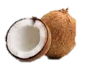
Sensory Analysis
2-a)Geraniol / Geranyl acetate (cont.) ^{[12]}
Panel:
7 females
Ages=(28-33)
Anosmia = 1
Geranyl
acetate
8-Oxogeranyl
acetate
8-Hydroxygeranyl
acetate
8-Carboxygeranyl
acetate
(Citrus, floral)
(Fatty, musty)
(Citrus, soapy)
(Coconut, plasticine!)
61.7 ng/L
22.1 ng/L
65.8 ng/L
39.7 ng/L
Odorant | Odor Threshold [ng/L(air)] |  |  |  |  |  |  | Group OT
 | P1 | P2 | P3 | P4 | P5 | P6 | P7
Geranyl acetate | 75.3 | 18.8 |  | 37.6 |  |  | 18.8 | 61.7
8-Oxogeranyl acetate |  | 13.5 | 54 | 13.5 | 27 | 13.5 | 108 | 22
8-Hydroxygeranyl acetate | 54 | 54 | 108 | 54 | 108 | 108 | 27 | 65.8
8-Carboxygeranyl acetate | 14 | 56 | 56 | N.O. | 28 | 28 | 112 | 39.7
151
151
151
6.75
[12] Elsharif and Buettner 2016

Slide 16
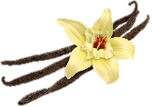
Sensory Analysis
2-b)Nerol / Neryl acetate ^{[12]}
Panel:
7 females
Ages=(28-33)
Anosmia = 1
Nerol
8-Oxonerol
8-Hydroxynerol
8-Carboxynerol
(Citrus, fresh)
(Fatty, musty)
(Vanilla, sweet)
(Fatty, waxy)
60.5 ng/L
494 ng/L
451 ng/L
210 ng/L
Odorant | Odor Threshold [ng/L(air)] |  |  |  |  |  |  | Group OT
 | P1 | P2 | P3 | P4 | P5 | P6 | P7
Nerol | 180 | 22.5 | 180 |  | 89.7 |  | 22.5 | 60.5
8-Oxonerol | 1620 | 50.6 | 810 | 203 | 203 |  | 405 | 494
8-Hydroxynerol | 901 | 113 | 901 | 225 | 451 |  | 225 | 451
8-Carboxynerol | N.O. | 74.2 | 594 | 74.2 | 74.2 |  | 74.2 | 210
11.3
180
6480
1803
4752
[12] Elsharif and Buettner 2016

Slide 17
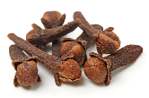
Sensory Analysis
2-b)Nerol / Neryl acetate (cont.) ^{[12]}
Panel:
7 females
Ages=(28-33)
Anosmia = 2
Neryl
acetate
8-Oxoneryl
acetate
8-Hydroxyneryl
acetate
8-Carboxyneryl
acetate
(Clove-like, phenolic)
(Citrus, musty!)
(Citrus)
(Plasticine, waxy)
96 ng/L
8.8 ng/L
85.7 ng/L
27 ng/L
Odorant | Odor Threshold [ng/L(air)] |  |  |  |  |  |  | Group OT
 | P1 | P2 | P3 | P4 | P5 | P6 | P7
Neryl acetate | N.O. |  | 216 | 27 | 27 | 27 |  | 96
8-Oxoneryl acetate | 13.1 | 26.2 | 13.1 | 26.2 | 3.27 |  | 26.2 | 8.8
8-Hydroxyneryl acetate | 216 | 54 | 54 | 216 | 27 | N.O. | 108 | 85.7
8-Carboxyneryl acetate | 27 | 13.5 | 6.75 | 216 | 6.75 | 54 | 54 | 27
432
432
0.41
[12] Elsharif and Buettner 2016

Slide 18
Structure Odor Relationship
2-Geraniol / Nerol (cont.) ^{[12]}
Geraniol
Nerol
14 ng/L
60.5 ng/L
(Citrus, floral)
(Citrus, fresh)
Geranyl acetate
Neryl acetate
(Citrus, floral)
(Clove-like, phenolic)
61.7 ng/L
96 ng/L
[12] Elsharif and Buettner 2016

Slide 19
Structure Odor Relationship
2-Geraniol / Nerol (cont.) ^{[12]}
Geraniol
Nerol
14 ng/L
60.5 ng/L
(Citrus, floral)
(Citrus, fresh)
8-Hydroxygeraniol
8-Hydroxygeranyl acetate
8-Hydroxyneryl acetate
8-Hydroxynerol
(Fatty, citrus, soapy)
(Citrus, soapy)
(Citrus)
(Vanilla, sweet)
340 ng/L
65.8 ng/L
85.7 ng/L
451 ng/L
[12] Elsharif and Buettner 2016

Slide 20
Structure Odor Relationship
2-Geraniol / Nerol (cont.) ^{[12]}
Geraniol
Nerol
14 ng/L
60.5 ng/L
(Citrus, floral)
(Citrus, fresh)
8-Oxogeraniol
8-Oxogeranyl acetate
8-Oxonerol
8-Oxoneryl acetate
(Fatty, musty)
(Fatty, musty)
(Fatty, musty)
(Citrus, musty!)
194 ng/L
22.1 ng/L
494 ng/L
8.8 ng/L
[12] Elsharif and Buettner 2016

Slide 21
Structure Odor Relationship
2-Geraniol / Nerol (cont.) ^{[12]}
Geraniol
Nerol
14 ng/L
60.5 ng/L
(Citrus, floral)
(Citrus, fresh)
8-Carboxygeranyl acetate
8-Carboxynerol
8-Carboxyneryl acetate
(Coconut, plasticine!)
(Fatty, waxy)
(Plasticine, waxy)
39.7 ng/L
210 ng/L
27 ng/L
[12] Elsharif and Buettner 2016

Slide 22
Sensory Analysis
3-β-Citronellol / Citronellyl acetate ^{[13]}
Panel:
5 females
Ages=(28-33)
Anosmia = 0
Citronellol
8-Oxocitronellol
8-Hydroxycitronellol
8-Carboxycitronellol
(Citrus, fresh, floral)
(Citrus, fresh, fatty)
(Citrus, fresh)
(Odorless)
10.5 ng/L
879 ng/L
233 ng/L
Odorant | Odor Threshold [ng/L(air)] |  |  |  |  | Group OT
 | P1 | P2 | P3 | P4 | P5
Citronellol | 9.2 |  | 18.4 | 4.6 | 36.8 | 10.5
8-Oxocitronellol |  |  | 505 |  | 505 | 879
8-Hydroxycitronellol |  |  |  |  |  | 233
8-Carboxycitronellol | - | - | - | - | - | -
4.6
4040
126
4040
405
25.3
405
405
405
[13] Elsharif and Buettner 2017

Slide 23
Sensory Analysis
3-β-Citronellol / Citronellyl acetate (cont.) ^{[13]}
Panel:
5 females
Ages=(28-33)
Anosmia = 0
Citronellyl
acetate
8-Oxocitronellyl
acetate
8-Hydroxycitronellyl
acetate
8-Carboxycitronellyl
acetate
(Citrus, fatty)
(Musty, fatty)
(Citrus, soapy)
(Odorless)
665 ng/L
346 ng/L
1261 ng/L
------
Odorant | Odor Threshold [ng/L(air)] |  |  |  |  | Group OT
 | P1 | P2 | P3 | P4 | P5
Citronellyl acetate | 877 | 877 |  |  | 439 | 665
8-Oxocitronellyl acetate | 173 | 346 |  |  | 346 | 346
8-Hydroxycitronellyl acetate | 1261 | 1261 |  |  | 1261 | 1261
8-Carboxycitronellyl acetate | - | - | - | - | - | -
219
1754
173
1382
631
2523
[13] Elsharif and Buettner 2017

Slide 24
Structure Odor Relationship
3-β-Citronellol / Citronellyl acetate (cont.) ^{[13]}
Citronellol
Citronellyl acetate
8-Hydroxycitronellol
8-Hydroxycitronellyl acetate
(Citrus)
(Citrus, fatty)
(Citrus, fresh)
(Citrus, soapy)
10.5 ng/L
665 ng/L
233 ng/L
1261 ng/L
8-Oxocitronellol
8-Oxocitronellyl acetate
(Citrus, fresh)
(Musty, fatty)
8-Carboxycitronellol
8-Carboxycitronellyl
acetate
879 ng/L
346 ng/L
(Odorless)
[13] Elsharif and Buettner 2017

Slide 25

A Comparative Approach: Alcohols ^{[14]}
Linalool
8-OL
8-HL
8-CL
Geraniol
8-OG
8-HG
8-CG
Nerol
8-ON
8-HN
8-CN
Citronellol
8-CC
8-OC
8-HC
[14] Elsharif and Buettner 2017

Slide 26
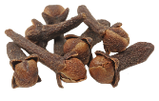
A Comparative Approach: Acetates ^{[14]}
Linalyl acetate
8-OLA
8-HLA
8-CLA
Geranyl acetate
8-OGA
8-HGA
8-CGA
Neryl acetate
8-ONA
8-HNA
8-CNA
Citronellyl acetate
8-HCA
8-CCA
8-OCA
[14] Elsharif and Buettner 2017

Slide 27
Conclusion ^{[14]}
8-Oxolinalyl acetate
Citrus
6 ng/L
Linalool
Citrus,
lemon-like
3.2 ng/L
Geraniol
Citrus,
fresh
11.5 ng/L
Nerol
Citrus,
fresh
68 ng/L
Citronellol
Citrus,
floral
11 ng/L
8-Hydroxylinalyl acetate
Citrus
120 ng/L
8-Hydroxy
linalool
Citrus
124 ng/L
8-Hydroxy
geraniol
Citrus
310 ng/L
8-Hydroxyneryl acetate
Citrus
85.7 ng/L
8-Oxogeranyl
acetate
Fatty, musty
20 ng/L
8-Hydroxycitronellyl acetate
Citrus
1261 ng/L
8-Carboxy
linalool
Odorless
[14] Elsharif and Buettner 2017

Slide 28

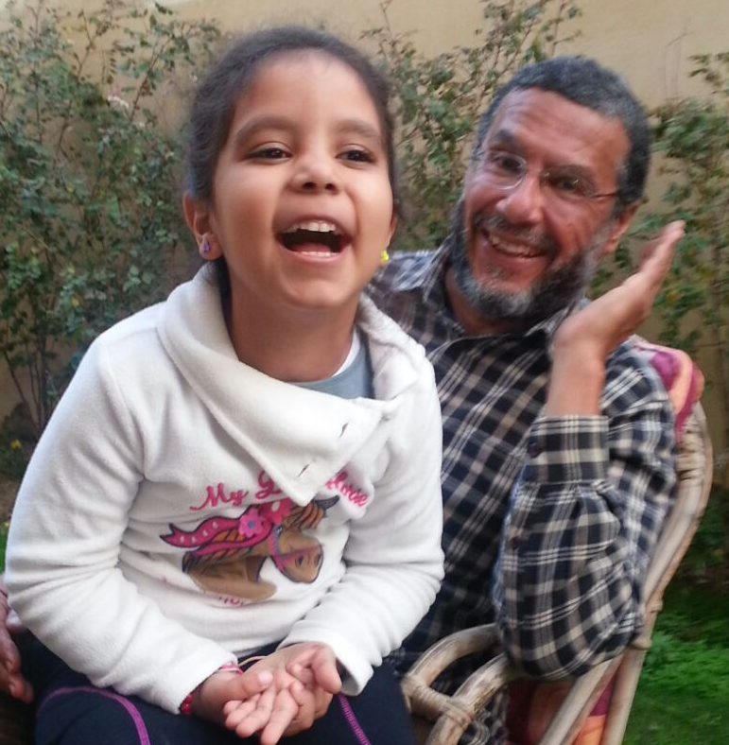

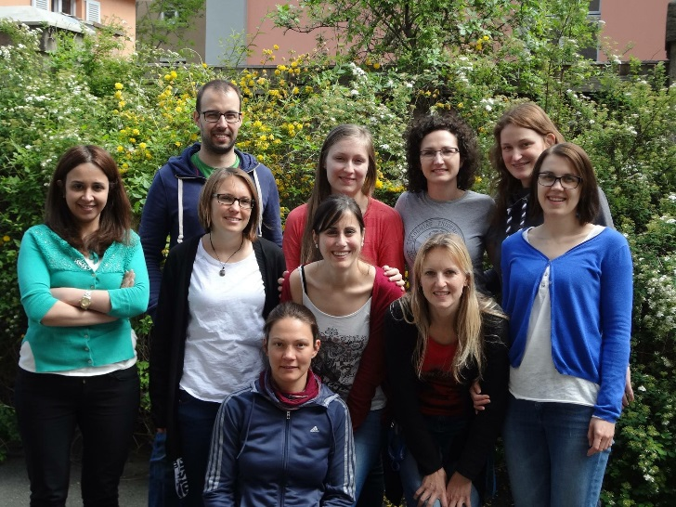
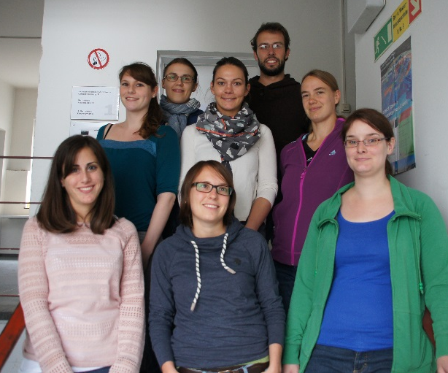
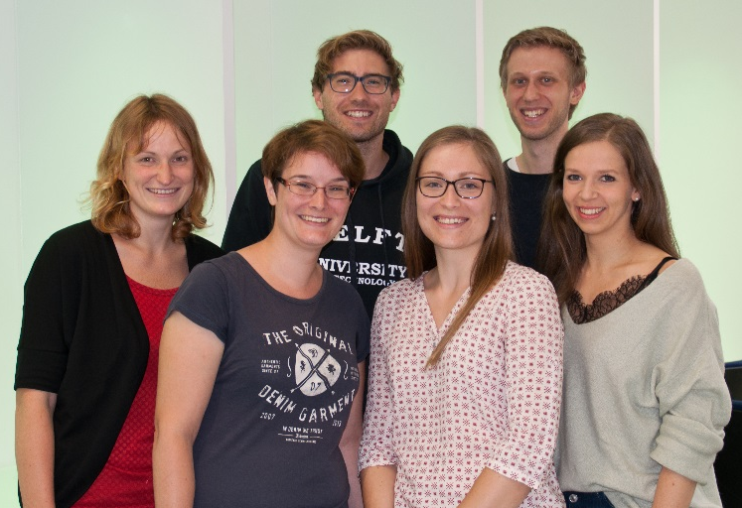
Acknowledgment

Slide 29

Thank you for your kind attention!

